Slide 1
Price Responsiveness and concept of elasticity (Mankiw Chapter 5, Powell Chapter 4)
Suppose, during elections, the parties declare a 5-day strike, disrupting transportation of goods from different countries. Or suppose, domestic firms have invested in a new technology, what would happen to the supply or demand?
The law of demand/supply explains a very simple relationship, BUT most of the times, this is not the case, we need to quantify our expectations or realities. By asking How much, or how little for both quantity and price.

Slide 2
Elasticity
Elasticity is a measure of how much buyers and sellers respond to changes in market conditions. When studying how some event or policy affects a market, we can discuss not only the direction of the effects but their magnitude as well.
The price elasticity of demand measures how much the quantity demanded responds to a change in price. Demand for a good is said to be elastic if the quantity demanded responds substantially to changes in the price. Demand is said to be inelastic if the quantity demanded responds only slightly to changes in the price.

Slide 3
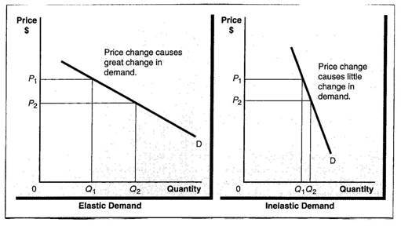
Elastic Demand and Inelastic Demand Curve

Slide 4
Price Elasticity of Demand (PED)
Economists calculate the price elasticity of demand as the percentage change in the quantity demanded divided by the percentage change in the price. That is, Price elasticity of demand
PED =% Change in quantity demanded/ %change in price

Slide 5
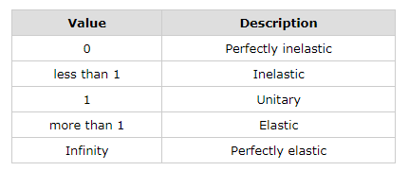
PED/PES

Slide 6
PED: Examples
Price of Public Transport (BDT) | Quantity Demanded by University Students | Quantity Demanded by Tourists
20 | 300 | 300
25 | 275 | 200
27 | 260 | 180
Calculate PED for group A and B, when Price decreases from 25 to 20. Comment on the elasticity.
Suppose the PED for NIKE shoes is 0.67 for University of students. What would be the percentage change in quantity demanded if prices increase by 20%.

Slide 7
Answers
0.45 inelastic. Most of the university students travel using public transportation. Hence, a change in price will not influence their quantity demanded as much. You can see from the equation that a 20% fall in price caused only 9.09% increase in quantity demanded.
2.5 elastic. Tourists tend to look for cheaper methods when travelling. Hence, a change in price will significantly influence their quantity demanded for public transportation. From the equation, you can see that a 20% fall in price caused 50% increase in quantity demanded.
2. Here, you are given PED and change in price for university students. Putting it in the formula, you get that a 20% increase in price resulted in a decrease in quantity demanded of 13.4%. You could comment by looking at the PED that demand is inelastic.

Slide 8
Determinants of PED
Availability of substitutes:
Substitutes for the product: Generally, the more substitutes, the more elastic the demand. If a product has many substitutes, and the price rises, consumers will have an elastic response because they can easily find alternative products.
2. Luxury or necessity:
Whether the product is a luxury or a necessity: Generally, the less necessary the item, the more elastic the demand. In the case of a luxury, if the price increases, consumers will just do without and have an elastic response.

Slide 9
Determinants of PED
3. Share of income spent:
Share of income spent on the good: Generally, the larger the expenditure relative to one’s budget, the more elastic the demand, because buyers notice the change in price more.
4. Time:
The amount of time involved: Generally, the longer the time period involved, the more elastic the demand becomes

Slide 10
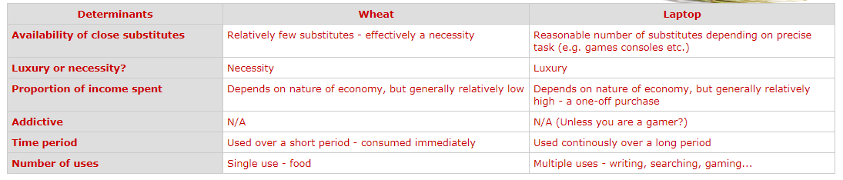
Determinants through a comparison

Slide 11
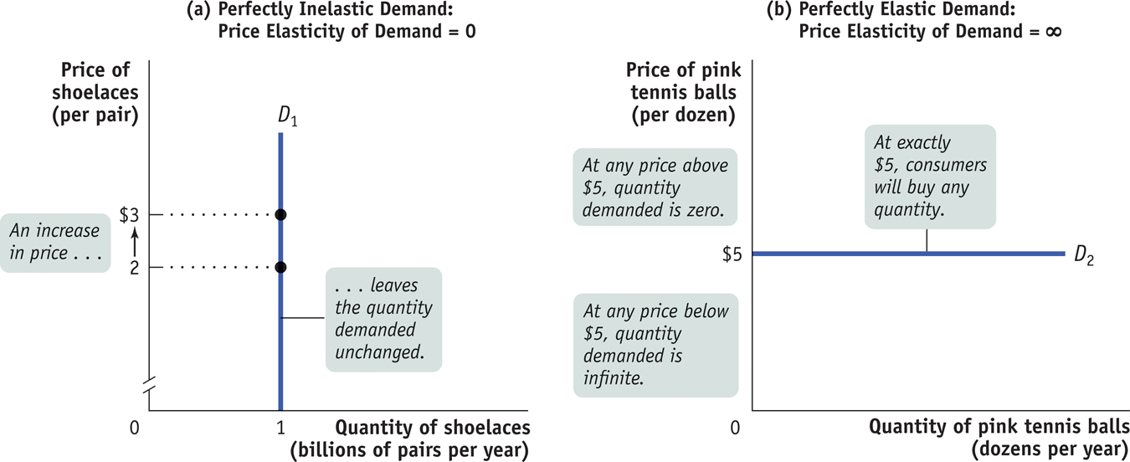
Three Extreme Cases of PED

Slide 12
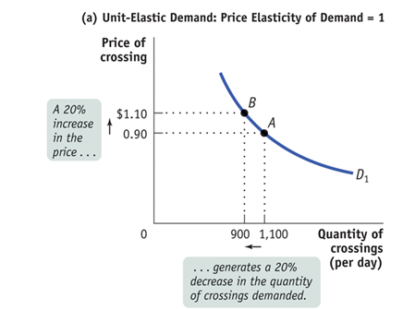

Slide 13
2. Price Elasticity of Supply PES
The law of supply states that higher prices raise the quantity supplied. The price elasticity of supply measures how much the quantity supplied responds to changes in the price.
PES = Percentage change in Supply/Percentage Change in Price
Formula: Look at the board

Slide 14
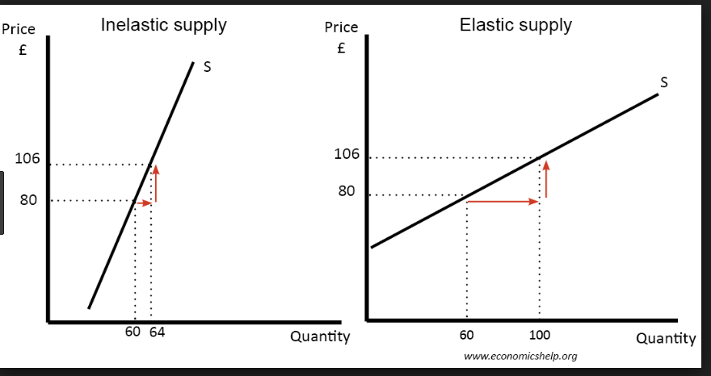
Price Elasticity of Supply

Slide 15
Example: PES
Price | Quantity Supplied of Ice-cream | Quantity Supplied of Tomatoes
25 | 200 | 200
30 | 300 | 220
40 | 350 | 280
Suppose when the price is BDT 25, quantity supplied of ice-cream is 200. If the price increases to BDT 40, what is the PES of ice-creams?
Suppose when the price is BDT 25, quantity supplied of tomatoes is 200. If the price increases to BDT 40, what is the PES for tomatoes?

Slide 16
Answers: PES
Elastic 1.25. Suppliers of ice-cream are able to quickly increase their supply when prices rise. Hence with a 60% increase in prices, suppliers are able to increase quantity supplied by 75%.
Inelastic 0.67. Suppliers of tomatoes are not able to increase their supply as quickly mainly because tomatoes are an agricultural good. Hence, an increase in prices of 60%, suppliers were able to increase 40% of supply.

Slide 17
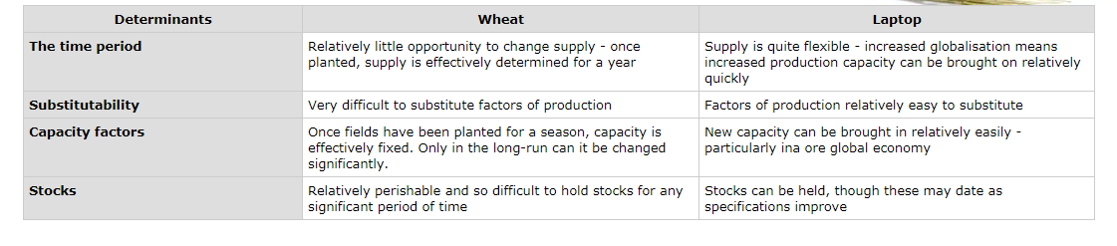
Determinants of PES

Slide 18
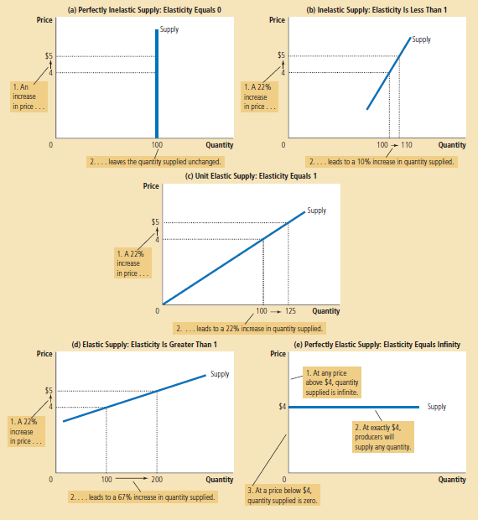

Slide 19
3. Income Elasticity of Demand (YED)
The Income Elasticity of Demand The income elasticity of demand measures how the quantity demanded changes as consumer income changes. It is calculated as the percentage change in quantity demanded divided by the percentage change in income. That is,
YED= %Change in quantity demanded/%Change in Income
Forumla: look at the board
If positive, then normal good.
If negative, then inferior good.

Slide 20
Examples of YED
Suppose the monthly income of an individual increases from Rs. 6,000 (Y) to Rs. 12,000 (Y1). Now, his demand for clothes increases from 30 units (Q) to 70 units (Q1) Calculate YED
Variations of YED:
More than Unitary Income Elasticity of Demand
Less than Unitary Income Elasticity of Demand:

Slide 21
4. Cross Elasticity of Demand (XED)
The cross-price elasticity of demand measures how the quantity demanded of one good responds to a change in the price of another good. It is calculated as the percentage change in quantity demanded of good 1 divided by the percentage change in the price of good 2. That is,
XED=% Change in QD of good 1/ %Change in Price of Good 2
Whether the cross-price elasticity is a positive or negative number depends on whether the two goods are substitutes or complements.
If positive, then substitute good. If negative, then complementary good.

Slide 22
Examples of XED (substitute)
The quantity demanded or product A has increased by 12% in response to a 15% increase in price of product B. Calculate the cross elasticity of demand and tell whether the product pair is (a) apples and oranges, or (b) cars and gas.
Cross elasticity of demand = % change in quantity demanded of A ÷ % change in price of B = 12%/15% = 0.67.
Since the cross elasticity of demand is positive, product A and B are substitute goods. They are most likely apples and oranges.

Slide 23
Examples of XED (Complements)
For example, if the price of Cinema Tickets increases from £5.00 to £7.50, and the demand for Popcorn decreases from 1000 tubs to 700, the XED between the two products will be:
XED= ? The negative sign means that the two goods are complements
Why find XED?
Knowing the XED of its own and other related products enables the firm to map out its market. Mapping allows a firm to calculate how many rivals it has, and how close they are. It also allows the firm to measure how important its complementary products are to its own products.
This knowledge allows the firm to develop strategies to reduce its exposure to the risks associated with price changes by other firms, such as a rise in the price of a complement or a fall in the price of a substitute.

Slide 24
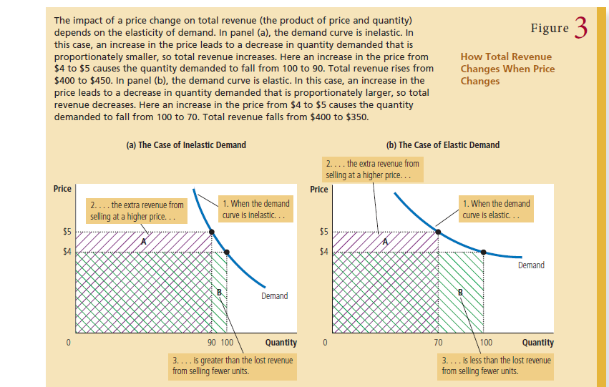
How to calculate Revenue?

Slide 25
TOTAL REVENUE
When there are changes in Price and Quantity, we expect changes in the revenue earned by suppliers of that market. The concept of elasticity is important to understand how much extra revenue will gain/lose if prices move up and down.
Meaning in conditions of elasticity.

